Slide 1
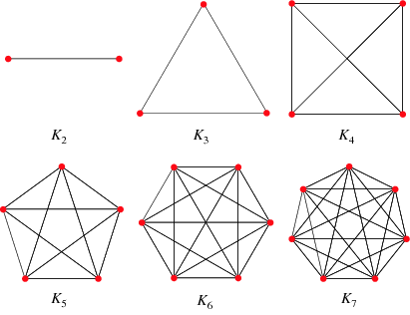
Discrete Mathematics
Unit 5
5
Graph theory

Slide 2
Simple graph:
A simple graph G(V, E) consists of a non empty set of vertices V and a set of unordered pairs of distinct elements of V called edges E.
Multi graph:
Any graph which consists some multiple (or parallel) edges is called a multi graph.
Pseudo graph:
A graph in which loops and multiple edges are allowed is called a pseudo graph.
Example:
Fig. (i)
Simple Graph
Fig. (ii)
Multigraph
Fig. (iii)
Pseudograph

Slide 3
NOTE:
1. A graph G consists of a set V called the set of nodes (or points or vertices).
2. A graph G consists of a set of edges such that each edges e={u, v} is represented by a
curve or a line segment which connects its endpoints u and v.
3. An edge of a graph that joins a node to itself is called a loop or self loop. i.e. Any edge
has initial and final vertex is same is known as loop.
4. Pair of vertices joined by more than one edges, such edges are called multiple
or parallel edges.
From above figure iii), we see that edge e₁={A,B}, loop e₂={B,B}, e₅= e₄ ={D,C} parallel edges.
Order of a graph:
The number of vertices in G is called the order of a graph G.
Size of a graph:
The number of edges in a graph G is called the size of graph G.
Adjacent vertices:
Any pair of vertices that is connected by any edge in a graph is called adjacent vertices.
Degree of vertices:
The degree (or valency) of a vertex V in graph G, written d(v) or deg(v) is equal to the number of edges are incident (contain) on v.

Slide 4
NOTE: A vertex is said to be even or odd according as its degree is an even or an odd number.
Example:
Deg(A) =2, deg(B) =3, deg(C) =3, deg(D) =2
Thus, the vertices A and D are even, B and C are odd.
Isolate vertex:
The vertex V is isolated if it does not belong to any edges. Thus V is isolated if and only if d(v)=0
In other words, A vertex of degree zero is called isolated vertex.
Finite graph:
A graph is said to be finite if it has a finite number of vertices and a finite number of edges.
Trivial graph:
The finite graph with one vertex and no edges i.e. a single point is called the trivial graph.
Pendant vertex
A vertex of degree one is called pendant vertex.

Slide 5


# Theorem 1 ( Handshaking theorem)
Statement: The sum of the degrees of the vertices of a graph is equal to twice the number of edges.
Proof:
Consider a graph G with n vertices v₁, v₂…….v_{n} and n_{e} edges. Since each edge contributes degree of 2, the sum of the degrees of all vertices in G is twice the number edges in G. i.e.
where, the sum of all the degrees of the vertices of graph G and n_{e} is the total
number of edges in G. This completes the proof.

Slide 6
Example:
Find the degree of total number of vertices of the following graph.
Here, the no. of edges = 10, Total no. of degree =2 *10 = 20
# Theorem (2) The number of odd vertices in a graph is always even.
Proof:
Let G=(V,E) a non directed graph. Let U denoted the set of even degree vertices in G and W denote the set of odd degree vertices.
then,

Slide 7
Now, is also even
Therefore from (i)
is even
Therefore, the number of odd vertices in G is even.

Slide 8
Special types of graph
Complete graph:-
A simple graph G is said to be complete if every vertex in G is connected with every other
vertex. i.e. if G contains exactly one edge between each pair of distinct vertices. The
complete graph with n vertices is denoted by k_{n}.
Note:(i) The total number of edges in a complete graph
K_{n} is
(ii) The degree of each vertex is n – 1 in a complete graph of n vertices
Example:
The complete graphs k₁, k₂, k₃, K₄ and k₅ are shown in figure.

Slide 9
Regular Graph:-
A graph in which all vertices are equal degree is called a regular graph. If the degree of each vertex is r, Then the graph is called a r-regular.
Example:
0-regular
1-regular
2-regular
3-regular
Note: If G has n vertices and is r-regular then G has edges.
Bipartite Graph:-
A graph G = (V,E) is bipartite if the vertex set V can be partitioned into two subsets (disjoint) V1 and V2 such that every edge in E connects a vertex V1 and a vertex V2 (so that no edge in G connects either two vertices in V1 or two vertices in V2).(V1,V2) is called a Bipartition of G.
Complete Bipartite Graph:-
The complete bipartite graph of m and n vertices, denoted by Km,n if each vertex of m is connected to each vertex of n, where |M| = m, |N| = n and m ≤ n

Slide 10
Example:
K 2,3
K3,3
K2,4
Note: The complete bipartite graph K_{m,n} consists of (m+n) vertices and m.n edges
Walk:-
A walk in a graph G is finite ordered set W={V0,E1,V1,E2,V2………. Vk-1,Ek,Vk} whose elements are alternately vertices and edges such that for 1 ≤ i ≤ k, the edge Ei has ends vertices Vi-1 and Vi.
The walk from V1 to Vn is denoted by (V1,V2,V3,……………..Vn)
Note: The number of edges in the walk is called length of W.

Slide 11
Example: the walk of v₁ to v₆ of the given graph,
V2
V4
V1
V3
V5
V6
The finite ordered set of vertices (V1,V2,V3,V4,V5,V₃,V6) is a walk of length 6.
Trial:-
A walk in which all the edges are distinct is called a trial.
Path:-
A walk in which all the vertices are distinct is called path.
Note:- A path must be a trial, A path with n vertices has length n-1.

Slide 12
Example: Find all path from V₁ to V₅ of the given graph,
V₁
V₂
V₅
V₃
V₄
Solution:
A walk from V₁ to V₅ is a path, if no vertex is repeated. There are four such paths
are as follows:
1. (V₁,V₂,V₅),
2. (V₁,V₂,V₄,V₅),
3. (V₁,V₃,V₄,V₅),
4. (V₁,V₃,V₄,V₂,V₅)

Slide 13
Closed path and closed trial:
A walk (a trial or path) in a graph G with initial vertex V₁, and final vertex V_{n} is closed if V₁= V_{n} and otherwise open.
Circuit:
A closed trial which contains at least three edges is called circuit.
Cycle:
A closed path which contains at least three edges is a cycle.
Note: Every cycle is a circuit but not the converse. A cycle of length K is called a K-cycle.
Connected Graph:-
A graph G is said to be connected if there is a path between any two of its vertices, otherwise G is disconnected.
Example:
V₂
V₁
V₂
V₃
V₄
V₁
V₄
V₃
Connected
Disconnected

Slide 14
Edge Connectivity:-
Let G be a connected graph the edge connectivity of G is the minimum number of edges whose removal results in a disconnected or trivial graph. the edge connectivity of a connected graph G is denoted by λ(G).
Vertex Connectivity:
Let G be a connected graph. The vertex connectivity of G is the minimum number of vertices whose removal results in a disconnected or a trivial graph. The vertex connectivity of a connected graph is denoted by K(G).
Summary
Term | Repeated edge | Repeated vertex
Walk | Allowed | Allowed
Trial | No | Allowed
Path | Allowed | No
Circuit | No | Allowed
Cycle | Allowed | No (first and last only)

Slide 15
Wheel graph:-
The wheel W_{n} is obtained when an additional vertex to the cycle C_{n} for n≥3 and connect this new vertex to each of the n vertices in C_{n} by new edges.
Example:
W₃
W₅
W₄
Platonic Graph:
The graphs formed by the vertices and edges of the five regular(platonic) solids-tetrahedron, cube, octahedron , dodecahedron, icosahedron called the platonic graphs.

Slide 16
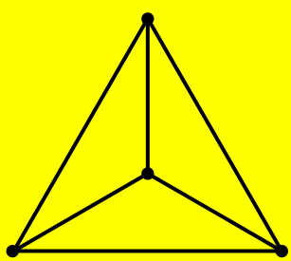
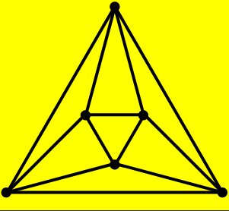
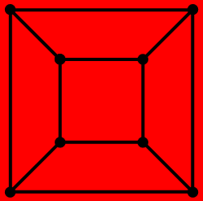
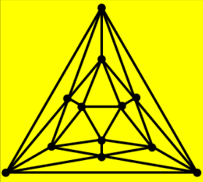
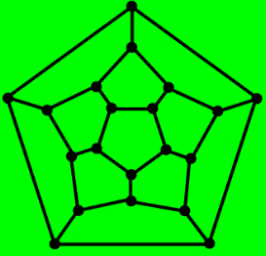
tetrahedron
octahedron
cube
icosahedron
dodecahedron

Slide 17
Below is a chart describing the regularity of the 5 platonic solids:
Platonic Solid | vertices | edges | Regularity
Tetrahedron | 4 | 6 | 3-regular
Octahedron | 6 | 12 | 4-regular
Cube | 8 | 12 | 3-regular
Dodecahedron | 20 | 30 | 3-regular
Icosahedron | 12 | 30 | 5-regular
Connected Component :-
A maximal connected sub graph of a graph G is called a connected component or simply component of G.
Cut Set :-
The set of all minimum number of edges of G whose removal disconnects a graph G is called a cut set.
Cut edge (Bridge) :-
An edge e is a bridge for G if G - e is disconnected.
Cut-vertex :-
A vertex V of a connected graph G is called a cut-vertex (or cut point). If the graph G - V is disconnected.

Slide 18
Example: Consider a graph G given in figure
The graph G₁ consists of two connected components.
The graph G - V₃ is disconnected, The vertex V₃ of the graph G is the cut-vertex.
Similarly,
The graph G₂ consists of three connected components. The graph G-e₁ or G-e₂ is disconnected. The edges e₁ and e₂ of the graph G is the cut edges.

Slide 19
Sub graphs :-
If G and H are two graphs with vertex sets V(H), V(G) and edge sets E(H) and E(G) respectively such that V(H) V(G) and E(H) E(G). Then we call H as a sub graph of G.
Proper Sub graph :-
Let H be a sub graph of G such that V(H) $≠$ V(G) or E(H) $≠$ E(G). Then, H is called a proper sub graph of G.
Spanning Graph :-
Let H be a sub graph of G with V(H) = V(G) i.e. H and G have exactly the same vertex set. Then H is said to be the spanning sub graph of G.
Note : A spanning sub graph need not contain all the edges in G.
Induced Sub graph G :-
if G is a graph with vertex set V and U is a subset of V. Then the sub graph G(U) with vertex set U and with edge set consisting of those edges of G that have both ends in U is called the induced sub graph.

Slide 20
Complement of G
Example:
G₁ is a sub graph of G, G₂ is induced sub graph of G.
Complement of Graph :-
The complement of a graph G is denoted by is defined as a simple graph with the
same vertex set as G. Two vertices are adjacent in if and only if they are not adjacent in G.

Slide 21
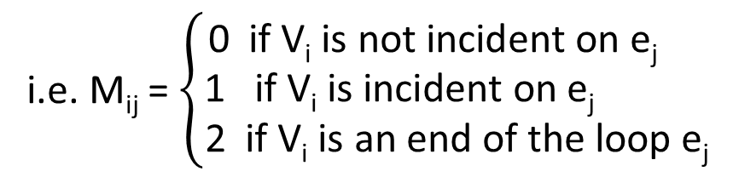
Incidence Matrix :-
let G be a graph with vertices V₁ , V₂ … V_{m} and edges e₁ , e₂ … e_{n} . The incidence matrix
of G, define by m(G) = (m_{iJ} )_{mxn} where m_{iJ} is the number of times that the vertex v_{i} is
incident on the edge e_{J} .
i.e. M_{ij} = $\left\{\begin{matrix}\text{0 } \text{if} \text{Vi} \text{is} \text{not} \text{incident} \text{on} \text{ej} \\ \text{1 } \text{if} \text{Vi} \text{is} \text{incident} \text{on} \text{ej} \\ \text{2} \text{if} \text{Vi} \text{is} \text{an} \text{end} \text{of} \text{the} \text{loop} \text{ej} \end{matrix}\right.$
Example : find the incidence matrix of the given graph G.
Solution:
the incidence matrix of the given graph is

Slide 22
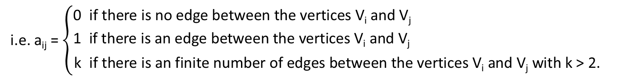
Adjacency Matrix :-
Let G be a graph with n vertices. The adjacency matrix of G defined by A(G) = [a_{iJ} ]_{nxn} such that
i.e. a_{ij} = $\left\{\begin{matrix}\text{0} \text{if} \text{there} \text{is} \text{no} \text{edge} \text{between} \text{the} \text{vertices} \text{Vi} \text{and} \text{Vj} \\ \text{1 } \text{if} \text{there} \text{is} \text{an} \text{edge} \text{between} \text{the} \text{vertices} \text{Vi} \text{and} \text{Vj} \\ \text{k} \text{if} \text{there} \text{is} \text{an} \text{finite} \text{number} \text{of} \text{edges} \text{between} \text{the} \text{vertices} \text{Vi} \text{and} \text{Vj} \text{with} \text{k}\text{ > 2. }\end{matrix}\right.$
Example : Find the adjacency matrix of the given graph G,
Solution:
the adjacency matrix of the given graph is
G

Slide 23
Isomorphic Graph :-
Let G₁ = (V₁ , E₁ ) and G₂ = (V₂ , E₂ ) be two graphs. A function f: V₁ → V₂ is called a isomorphism graphs. If (a) f is one to one and (b) for all a,b ∈ V₁ , {a,b} ∈ E₁ if and only if {f(a), f(b)} ∈ E₂ when such a function exists, G₁ and G₂ are called isomorphic graphs and is written as G₁ ≅ G₂ .
Example : Show that the two graphs shown in figure are isomorphic.
Solution:-
Here, V(G₁ )={1, 2, 3, 4}, V(G₂ )={a, b, c, d}
E(G₁ )={{1,2}, {2,3}, {3,4}} and E(G₂ )={{a, b}, {b, d}, {d, c}}
Define a function f : V(G₁ ) → V(G₂ ) as f(1) = a, f(2) = b, f(3) = c, f(4) = d
Therefore, f is clear one to one and onto, hence G₁ and G₂ are isomorphic.

Slide 24
Further, {1,2} ∈ E(G₁ ) and {f(1), f(2)} = {a,b} ∈ E(G₂ )
{2,3} ∈ E(G₁ ) and {f(2), f(3)} = {b,d} ∈ E(G₂ )
{3,4} ∈ E(G₁ ) and {f(3), f(4)} = {d,c} ∈ E(G₂ )
Note :- If G₁ and G₂ are isomorphic graphs, Then G₁ and G₂ have the
Same number of vertices
Same number of edges
Same degree sequences
Self Complementary :-
A simple graph G is called self-complementary if G and Ĝ are isomorphic.
Example:
•
•
•
•
•
Ĝ

Slide 25
Problem set 1 1) Draw the following graph: i) The complete graphs K₆,K₇ and K₈ ii) The complete bipartite graph K_{2,4} and K_{4,5} iii)Two 3- regular graph with six vertices. Iv) Two 3- regular graph with five vertices. 2) How many edges has each of the following graph ? i) K₂₄ , ii) K_{5,8} , iii) K₁₃ , iv) K_{3,3} 3) Consider the graph G shown in figure. Find all trails from V₁ to V₆
•
•
•
v₁
v₂
v₃
•
•
•
v₄
v₆
v₅

Slide 26
4) Consider the graph G shown in figure. Find all path and cycle. 6) Find the incidence matrix and adjacency matrix of the given graph.
•
v₁
v₂
•
•
v₃
e₃
•
•
v₅
e₂
v₄
V₁
v₂
e₁
e₄
e₅
v₃
v₄
e₆

Slide 27

7) Draw the graph G whose adjacency matrix A(G) is Also find number of loops and parallel edges. 8) Show that the following graphs are isomorphic. a)
•
•
•
•
•
•
•
•
•
•
•
•
•
•
_{H}
_{G}

Slide 28
b)
c)

Slide 29
d)
9) Show that the graphs G and H are not isomorphic
s
t
w
x
y
z
v
u
H

Slide 30
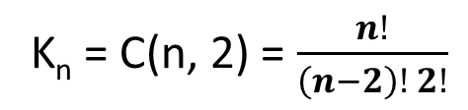
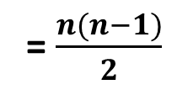
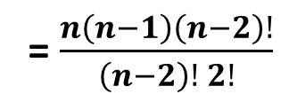
Properties of a graph (with Proofs)
Total number of edges in a complete graph K_{n} is $\frac{n(n−1)}{2}$
Proof:
An edge in K_{n} is constructed by choosing any two vertices out of a set of n vertices and joining them. The number of ways of choosing any two vertices out of n vertices is C(n,2). The total number of edge in a complete graph
K_{n} = C(n, 2) = $\frac{n!}{\left(n−2\right)! 2!}$
= $\frac{n\left(n−1\right)\left(n−2\right)!}{\left(n−2\right)! 2!}$
= $\frac{n(n−1)}{2}$
2. The number of vertices in a r-regular graph is even if r is odd.
Proof:
Let ‘S’ be the sum of the degrees of an r-regular graph with ‘n’ vertices then,
S = r.n
Since the sum of degree’s is twice the number of edges, the sum ‘S’ must be even, Since r is odd Then n must be even.

Slide 31
3. The complete graph K_{n} is the regular graph of degree n – 1.
Proof:
In a complete graph K_{n} there exists exactly one edge between any pair of vertices. Since each vertex joined to every other n – 1 vertices through an edge, then the degree of each vertex is n – 1 in a complete graph of n vertices. Hence every vertex in K_{n} has degree n – 1
Thus K_{n} is regular of degree n – 1.
4. In the cyclic graph C_{n} Size of C_{n} is equal to the order of C_{n}.
Proof:
The cyclic graph C_{n} consists of n vertices and n edges i.e. Equal number of vertices and edges. Thus, in the cyclic graph C_{n} Size of C_{n} is equal to order of C_{n}.

Slide 32
5. The size of W_{n} is twice the size of C_{n}.
Proof:
The wheel graph is obtained from the cycle graph C_{n} by adding a vertex inside and connecting this new vertex to each of the n vertices in C_{n} by new edge, we get n new edges. Therefore the total number of edges in W_{n} is twice the number of edges in C_{n}. Thus size of W_{n} = 2(size of C_{n}).
6. The sum of the degree of the vertices in W_{n} is four times the size of C_{n}.
Proof:
We know that the sum of the degrees of vertices in G is twice the number of the edges in G. So, sum of degrees of vertices in W_{n} is twice the number of edges in W_{n}.
i.e. Sum of degrees of the vertices in W_{n}
= 2(number of edges in W_{n}).
= 2(2×number of edges in C_{n})
= 4(number of edges in C_{n}).
Hence, the sum of degrees of vertices in W_{n} is four times the size of C_{n}.

Slide 33
7. A graph G is a bipartite graph if it contain no odd cycle.
Proof:
Let G=(X,Y,Z) be a bipartite graph, it is easy to see that if there is a cycle C in G, C should have an even number of vertices (and therefore an even number of edges). Since the vertices of C are alternatively from X and from Y . Thus C is an even cycle.
Conversely:
Suppose that all cycle have even length. Pick some vertex X_{i} in each connected component C_{i} of G and let X and Y be the sets of vertices reached from some X_{i} by a path with an even or odd number of edges respectively. Then X and Y are disjoint and form a bipartition of V.
8. Size of the complete bipartite graph K_{m,n} is m × n
Proof:
Let the number of edge in K_{m,n} be P. The degree of each vertex in m is n and the degree of each vertex in n is m. The sum of degrees of the m vertices is m.n. The sum of degrees of n vertices is m.n. The Sum of the degrees of all the vertices is 2mn =2P(no. of edges)
i.e. P = m × n
9. K_{m,n} graph is a regular graph of degree m when m = n.
Proof:
The total number of vertices of K_{m,n} is m+n . The degree of each vertices is m
Since m = n, So it is a regular graph.

Slide 34
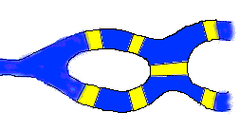
Traversability
Can you cross all seven bridges?

Slide 35
Konigsberg Bridge Problem (Cont.)
c
C
lands
d
g
lands
A
island
e
D
lands
C
f
g
a
B
c
d
b
e
A
D
a
b
f
B

Slide 36
Konigsberg Bridge Problem
Four land areas A, B, C, D have this river on their borders.
The four lands are connected by 7 bridges a – g.
Determine whether it’s possible to walk across all the bridges exactly once in returning back to the starting land area.
Euler showed that there is a walk starting at any vertex, going through each edge exactly once and terminating at the start vertex iff the degree of each vertex is even. This walk is called Eulerian.
No Eulerian walk of the Konigsberg bridge problem since all four vertices are of odd edges.
Eulerian Circuit:
A circuit(closed trial) containing all the edges of a graph (multi graph) G is called an Eulerian circuit.
Eulerian Graph:
A graph containing an Eulerian Circuit is called an Eulerian Graph.
Eulerian Trial:
A trail containing all the edges in a graph G is said to be Eulerian trial.
Note: Eulerian trial is also known as Traversable Graph

Slide 37
Theorem: (without proofs) a) A connected graph G is Eulerian if and only if each vertex has even degree. b) A connected graph G has Eulerian trial if and only if it has exactly two odd vertices.
Question: Write the necessary and sufficient condition for the graph to be Eulerian??
A connected graph is Eulerian if and only if each vertex has even degree.
Hamiltonian Graph:
A path containing every vertex of a Graph G is called Hamiltonian Path.
Hamiltonian cycle:
A cycle which contains every vertex of Graph G is called Hamiltonian cycle or Hamiltonian Circuit
Theorem: (without proofs)
a) (Ore’s) A connected graph with n vertices is Hamiltonian if for any two non-adjacent vertices u and v, deg(u) + deg(v) ≥ n.
b) (Dirac) A connected graph with n(>2) vertices is Hamiltonian if degree of every vertex is at least n/2 .

Slide 38
Note: Total number of Hamiltonian cycle in a complete graph K_{n} is $\frac{\left(n−1\right)!}{2}$
Example:
Show that the Complete graph k_{n} is Hamiltonian for all n>2
Solution: Since,
and vertex has degree n – 1, then from Dirac theorem, the complete graph K_{n} with n vertices is Hamiltonian.

Slide 39
Problem set 1: Test each of the following graphs for Eulerian circuits and Hamiltonian cycles. 1) 2) K₄ 3) K₅ 5) K_{3,3} 6) K_{4,4} 7) K_{3,4} 8) K_{3,5} n 9) verify i) Every Eulerian graph is Hamiltonian. ii) Every Hamiltonian graph is Eulerian.
v₁
•
•
v₂
v₁
v₂
v₃
v₅
•
•
v₆
v₄
•
•
v₆
v₅
v₄
v₃
_{I}
_{II}

Slide 40
Directed Graph
v₁
e₁
•
˃
•
v₂
e₂
e₃
˃
e₄
˃
˃
e₅
˃
•
•
v₄
˃
v₃
˃
e₆

Slide 41
Digraph: A directed graph or digraph consists of a finite set V of vertices or a points and a finite set E of directed edges or arcs of ordered pairs (u ,v) of vertices. Directed graph is denoted by D (V,E)
Example:
e₁
˃
v₁
•
•
˃
v₂
e₂
e₃
˃
e₄
˃
e₅
˃
•
•
v₄
˃
˃
v₃
e₇
e₆

Slide 42
Consider the graph D(V,E)
where V = {v₁, v₂, v₃, v₄} and E = {e₁, e₂, e₃, e₄, e₅, e₆, e₇}
Where, e₁= (v₁,v₂), e₂ = (v₁,v₂), e₃=(v₁, v₃), e₄=(v₃, v₁), e₅=(v₂, v₄), e₆=(v₄, v₃), e₇= (v₄,v₄).
The edge such as e₇ = (v₄, v₄) beginning and terminating at the same point is a loop.
The edges such as e₁ =(v₁, v₂), e₂= (v₁, v₂) having the same initial vertex and the same terminal vertex are parallel edge or arcs.
The edge such as e₃=(v₁,v₃), e₄=(v₃, v₁) incidence on the same vertices are not parallel as they have the different initial are terminal vertices.

Slide 43
Diagraph and relation
If A and B are non empty sets, a relation R from A to B is a subset of A×B. If R ⊆ A×B and (a,b) ∈ R, we say that a is related to b by R we write _{a}R_{b}, it is denoted by D(V,R)
Eg: let V= {1,2,3} R={(1,1), (1,2), (1,3), (2,3)}
1
˃
2
3

Slide 44
Reflexive
A relation is reflexive if and only if there is a loop at every vertex of the directed graph.
Symmetric
A relation is symmetric if and only if for every edge between distinct vertices in its digraph there is an edge in the opposite direction
Transitive
A relation is transitive if and only if, whenever there is an edge from a vertex x to a vertex y and an edge from a vertex y to a vertex z, There is an edge from x to z.

Slide 45
In degree
In a directed graph, the indegree of V, denoted by indeg(V) or deg⁻ (V) is the number of edges ending at V.
Out degree
In a directed graph, the out degree of a vertex V of G denoted by outdeg(V) or deg⁺ (V) is the number of edges beginning at V.
Source
A vertex with zero in degree is called a source.
Sink
A vertex with zero out degree is called a sink

Slide 46
v₁
e₁
Example:
Therefore,
v₄ is a source and V₂ is a sink vertex.
•
˃
•
v₂
e₂
e₃
˃
e₄
˃
˃
e₅
˃
e₇
•
•
v₄
˃
v₃
˃
e₆
 | v₁ | v₂ | V₃ | v₄ | total
In degree | 1 | 3 | 3 | 0 | 7
Out degree | 2 | 0 | 2 | 3 | 7

Slide 47
Theorem: In a digraph the sum of the in degree of vertices , the sum of the out degree of the vertices and number of edges are equal to each other.
Proof: Any directed edge(u , v) contributes 1 to the in degree of v and 1 to the out degree of u. Further, a loop at v contributes 1 to the indegree and 1 to the outdegree of v. Hence, The sum of in degree of the vertices and the sum of out degree of the vertices which is equals the number of edges in G.

Slide 48
Connectivity of Digraphs
Underlying graph: A digraph D, we can obtain a graph G formed by removing all the direction from the edges is called the Underlying graph of the digraph D.
Directed Walk: Let D be a digraph, then a directed walk W in D is finite ordered set of vertices and directed edges alternately , which is expressed as: w=(v₀ ,e₁ ,v₁ ,e₂ ,v₂ ….e_{n} , v_{n})

Slide 49
Directed Path: A directed path in a digraph D is a directed walk in which every vertex is distinct.
Directed Cycle: A directed cycle in a digraph D is a directed path in which all the vertices are distinct except the first and last vertices.
Directed Trial: A directed trial in a digraph D is a directed walk in which all the directed edges are distinct.

Slide 50
Spanning Path: A spanning path of digraph D is the directed walk containing all the vertices of D.
Reachable: A vertex V of the digraph D is said to be reachable from a vertex u if there is a directed path in D from u to v.
Example: Here, v₃ is reachable from
V₁ through the directed path
{v₁,v₂,v₃}.
V₄ is not reachable from v₃, since,
There is no directed path from v₃ to
V₄.
v₁
v₂
˃
˃
˃
˃
v₃
˃
v₅
˃
˃
v₄

Slide 51
Weakly Connected: A digraph D is said to be weakly connected if its underlying graph is connected.
Unilaterally Connected: If there is a directed path from v_{i} and v_{j} or from v_{j} to v_{i} , then the digraph D is said to be unilaterally connected.
OR, A digraph D is said to be unilaterally connected, if the vertex v_{i} is reachable from v_{j} or the vertex v_{j} is reachable from v_{i}.
Strongly Connected: A digraph D is said to be Strongly connected, if for any pair of vertices v_{i} and v_{j} in D, v_{i} is reachable from v_{j} and v_{j} is
reachable from v_{i}.

Slide 52

Theorem (without proof)
A digraph D is unilaterally connected if it has a spanning path in D.
A diagraph D is strongly connected if it has a closed spanning path in D.
Incidence Matrix:
The incidence matrix B={b_{ij}} of digraph D with n vertices and m edges is the n×m matrix in which :

Slide 53
Example: The incidence matrix of the given graph is
v₁
e₁
•
v₂
˃
•
˃
e₅
e₄
˃
˃
e₂
•
•
v₄
˃
v₃
e₃

Slide 54
Shortest path problem (Dijstra’s Algorithm)
Note:
1. Solution to the single - source Shortest path problem in graph theory.
2. Both directed and undirected graph
3. All edges must have non negative weight
4. Graph must be connected.
5. It is applied on weighted graph.

Slide 55
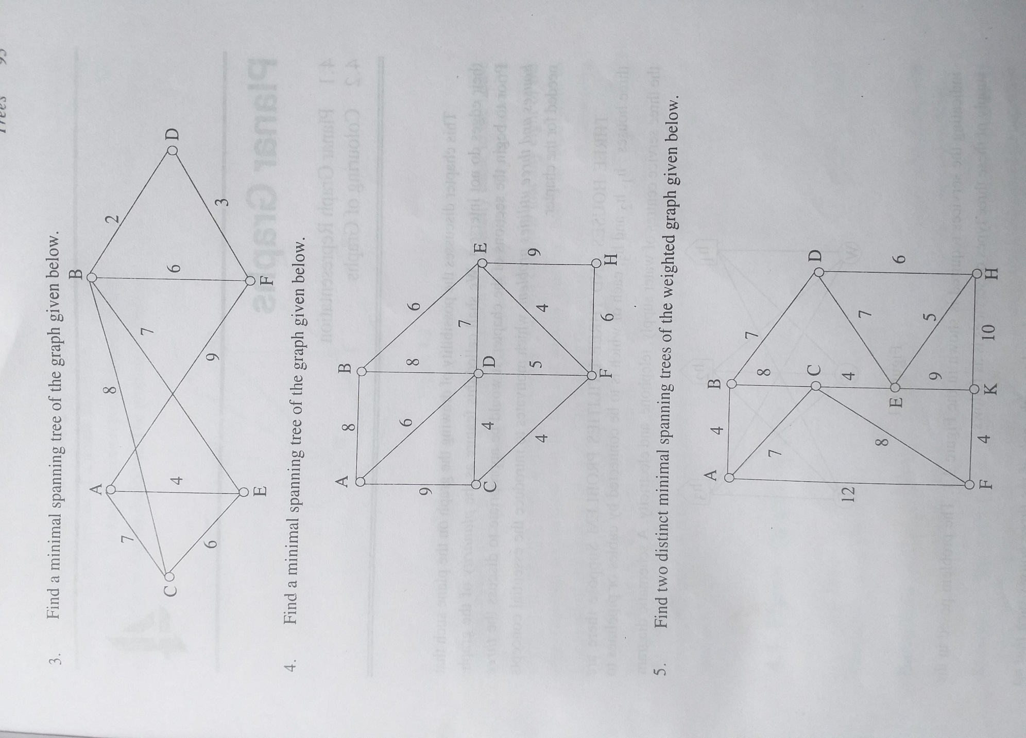
Example: Find the shortest path from vertex A to D in the given weighted graph by
Dijkstra algorithm.
Solution:
Selected vertex set P = {A},
Unselected Vertex set T = {B, C, D, E, F}
Iteration I
P = {A},
T = {B, C, D, E, F}
L(B) = ∞,
L(C) = 7,
L(D) = ∞,
L(E) = 4,
L(F) = 9
Therefore, minimum length is 4.

Slide 56
Iteration II
P = {A, E},
T = {B, C, D, F}
L(B) = min{∞, 4+7}=11,
L(C) = min{7, 4+6}=7,
L(D) = min{∞, ∞}= ∞,
L(F) = min{9, ∞}= 9,
Therefore, minimum length is 7.
Iteration III
P = {A, E, C},
T = {B, D, F}
L(B) = min{11, 7+8}=11,
L(F) = min{9, ∞}= 9,
L(D) = min{∞, ∞}= ∞,
Therefore, minimum length is 9.
Iteration IV
P = {A, E, C, F},
T = {B, D, }
L(B) = min{11, 9+6}=11,
L(D) = min{∞, 9 + 3}= 12,
Therefore, minimum length is 11.

Slide 57
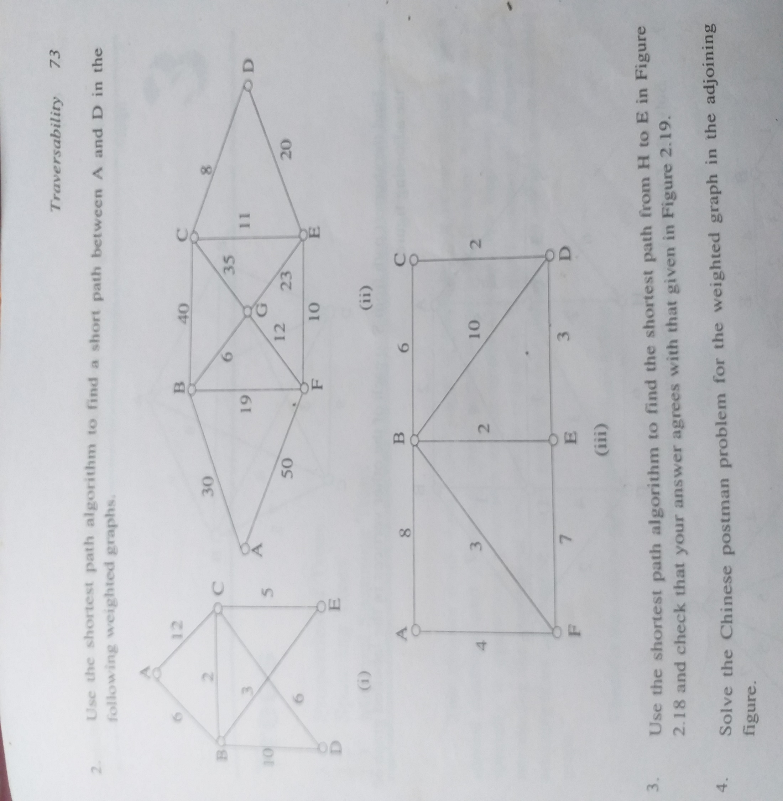
Iteration V
P = {A, E, C, F, B},
T = { D }
L(D) = min{12, 11 + 2}= 12,
Therefore, minimum length is 12.
Thus the shortest path from A to D is A – F – D and its minimum length is 12.
Class work : Find the shortest path from vertex A to D in the given weighted graph by
Dijkstra algorithm.

Slide 58
Travelling Salesman problem
Condition of Travelling Salesman problem: The salesman starts from his home city, he must
visit every city exactly once and returns to his home city.
The problem is to find the route shortest distance/ time/ cost.
Example:
Solve the Travelling Salesman problem for this graph by finding the total weight of all Hamilton circuits and determining a circuit with minimum total weight.
a
3
b
5
4
6
2
c
d
7

Slide 59
a
3
b
5
4
6
2
c
d
7
c
a
5 + 6 + 4 + 2 = 17
b
d
c
b
a
5 + 7 + 4 + 3 = 19
a
c
d
b
a
2 + 7 + 6 + 3 = 18
b
d
b
a
d
2 + 4 + 6 + 5= 17
c
a
c
3 + 6 + 7 + 2= 18
d
a
3 + 4 + 7 + 5= 19
Thus the minimum weight of Hamilton circuits are 17

Slide 60
Class work: Solve the Travelling Salesman problem for this graph by finding the total weight of all Hamilton circuits and determining a circuit with minimum total weight.
a
•
3
4
e
3
3
•
•
b
3
2
1
2
•
d
•
3
c

Slide 61
Planar Graphs and its Applications
Planar Graph:
A connected graph can be drawn without any edges crossing, it is called planar graph. When a planar graph is drawn in this way, it divides the plane into regions called faces.
example:
•
•
•
•
•
•
Note:
When is it possible to draw a graph so that none of the edges cross? If this is possible, we say the graph is planar (since you can draw it on the plane).
K₄ Drawn with
no crossing edges
The graph
K₄

Slide 62
Faces (regions)
A planar representation of a graph divides the plane into a number of connected regions: faces.
Each face is bounded by edges
One of the faces encloses the graph: exterior face.
•
•
example:
R₁
R₄
R₁
•
R₅
R₂
R₃
R₂
•
R₄
R₃
•
•
Euler's Formula for Planar Graphs.
For any connected planar graph with v vertices, e edges and f faces, we have
f = e – v + 2
example:
suppose that a connected planar simple graph has 20 vertices, each of degree 3. Into how many regions does a representation of this planar graph split the plane?

Slide 63
Solution:
This graph has 20 vertices, each of degree 3, so that v = 20. since the sum of the
degrees of the vertices, 3v = 3×20 = 60, is equal to twice the number of edges,
We have 2e = 60, or e = 30. consequently, from Euler's Formula,
The number regions is r = e – v + 2 = 30 – 20 + 2 = 12.
Corollary 1: For any simple, connected, planar graph G, with |E| > 2, the following holds:
|E| ≤ 3n – 6
Corollary 2: For any simple connected bipartite planar graph G, with |E| > 2, the following holds: |E| ≤ 2n – 4
Example:
K₅ cannot be planar
Solution:
It has 5 vertices and 10 edges. Then by corollary ,
|E| ≤ 3n – 6 ⇒ 10 ≤ 3*5 – 6 = 9 which is not true, so K₅ cannot be planar
Example:
K_{3,3} cannot be planar:
Solution:
It has 6 vertices and 9 edges Then by corollary of connected bipartite planar graph . |E| ≤ 2n – 4 ⇒ 9 ≤ 2*6 – 4 = 8, which is not true, so K_{3,3} cannot be planar
Note: All corollaries are necessary, but not sufficient conditions.

Slide 64
Graph coloring
DEFINITION
Graph coloring is simply assignment of colors to each vertex of a graph so that no two adjacent vertices are assigned the same color.
Example:
Chromatic Number:
The smallest number of colors needed to color a graph G is called its chromatic number. For example, the following can be colored minimum 2 colors.
Chromatic number of this graph is 2 ( Χ(G) = 2) because in this above diagram we can use to color red and green

Slide 65
Example:
Problem: Say algebra and statistics exam is held on same day then students taking both courses have to miss at least one exam. They can’t take both at same time. How do we schedule exams in minimum no of days so that courses having common students are not held on same day?
Solution: Graph coloring.
First draw a graph with courses as vertex and they are connected by edges if they have common students. Second color the graph such that no two adjacent vertices are assigned the same color as shown below:
Algebra
Physics
Statistics
Calculus
Look at the above graph. It solves our problem. We can conduct exam of courses on same day if they have same color.
Our solution: DAY 1: Algebra and Physics DAY 2: Statistics and Calculus
This solves our problem of scheduling exams so that all students can take exams without worrying about missing one.

Slide 66
Example:
What is the Chromatic Numbers of the graph G and H shown in figure below?
a
b
f
c
e
d
H
G
Solution:
the Chromatic Numbers of the graph G at least two, since the vertices a, e and c must be assigned same color because they are non adjacent vertices, also the vertices b, d and f must be assigned same color because they are non adjacent vertices. So χ(G) = 2. shown in figure below

Slide 67
a
a
b
b
f
f
c
c
e
e
d
d
χ(G) = 2
χ(G) = 2

Slide 68
You
Thank

Slide 69
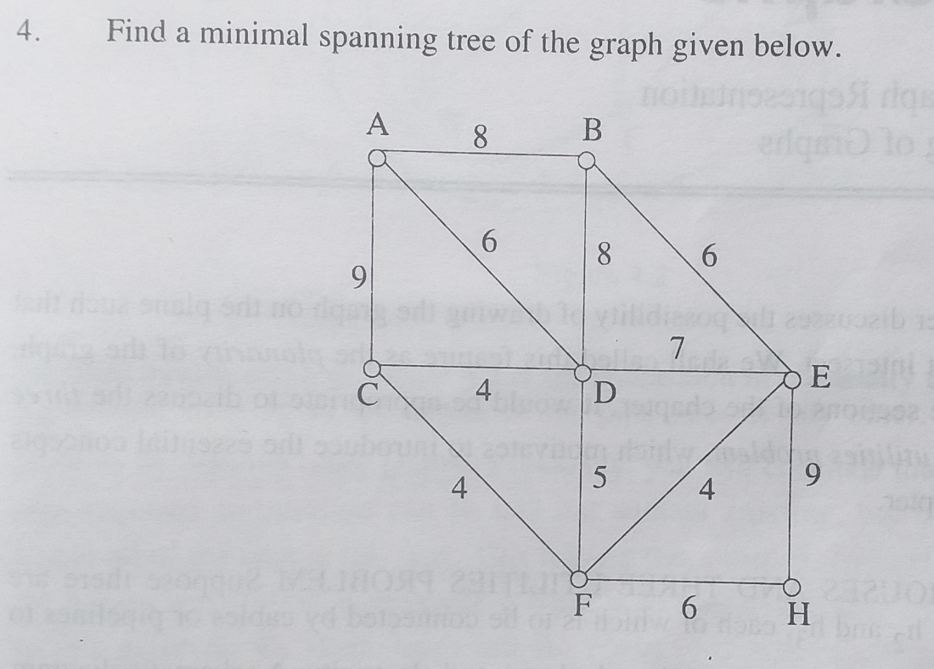

Slide 70
